Slide 1
Library I/O Functions
CptS 360 Systems Programming
School of Electrical Engineering and Computer Science
Washington State University
Hassan Ghasemzadeh (hassan.ghasemzadeh@wsu.edu)

Slide 2
Topics
Differences between system calls and library I/O functions
Example #1 (a ‘cat’ program)
Example #2 (a ‘copy’ program)
Algorithms of library I/O functions
Library I/O modes

Slide 3
Library I/O Functions
Why I/O functions?
User convenience
Efficiency
How do I/O functions provide convenience and efficiency?
System calls are basis of file operations
But system calls support read/write of chunks of data
Programs need to read/write files in units such as chars, lines, etc.
I/O functions provide such convenience and efficiency
Yet, the actual kernel-level functions are performed by issuing systems calls that lead to entering kernel and executing kernel functions

Slide 4
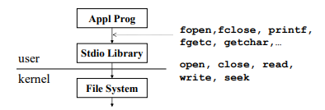
Library I/O functions vs. system calls
Library I/O functions are built on top of system calls in Linux
System Call Functions: open(), read(), write(), lseek(), close();
Library I/O Functions: fopen(), fread(), fwrite(), fseek(), fclose();
Example
fopen() relies on open()
fread() relies on read(), etc.

Slide 5
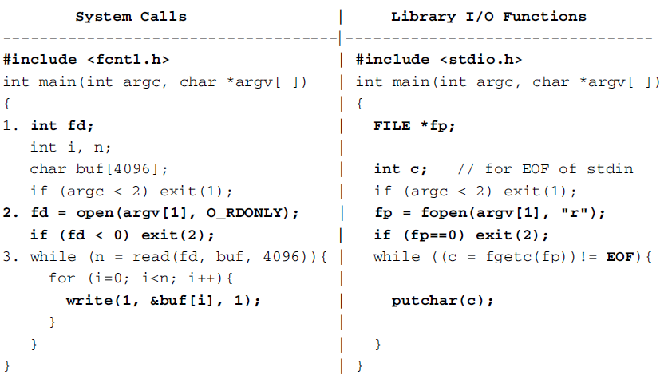
Example #1: Library I/O functions vs. system calls
a similar program that uses library I/O functions
a program that uses system calls
Both programs print the contents of a ﬁle to the display screen (similar to ‘cat’ command.

Slide 6
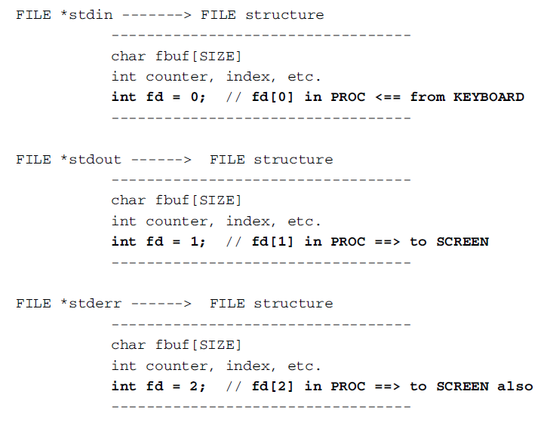
Example #1 (cont.)
recall this
‘fd’ is an integer
‘fp’ is pointer to a file structure
Use fgetc to get chars from file stream
Then output them by putchar() until EOF
‘reads’ up to 4K during each iteration of ‘while’ loop
Then ‘write’ each char to stdout

Slide 7
Example #1 (cont.)
System call program
File descriptor fd is an integer
System call open() opens a ﬁle for read and returns an integer ﬁle descriptor fd, or -1 if open() fails
system call program uses a while loop to read/write the ﬁle contents. In each iteration, it issues a read() system call to read up to 4KB chars into a buf[ ]. Then it writes each char from buf[ ] to the ﬁle descriptor 1, which is the standard output of the process.
Library I/O program
fp is a file stream pointer
Function fopen() returns a file structure pointer, or NULL if fopen() fails.
Library I/O program uses fgetc(fp) to get chars from file stream, output them by putchar() until EOF
Using system calls to write one byte at a time is inefﬁcient

Slide 8
Example #1 (cont.)
How does fopen() works in the library I/O function program?
Issues open() system call to get a ﬁle descriptor fd
If open() fails, it returns a NULL pointer. Otherwise, it allocates a file structure in the program’s heap area
File structure contains a buffer char fbuf[SIZE] and an integer fd ﬁeld
fopen() records ﬁle descriptor returned by open() in file structure, initializes fbuf[ ] as empty, and returns address of file structure as fp
snippet from I/O function program
file structure

Slide 9
Example #1 (cont.)
How does fgetc() work in the library I/O function program?
fgetc(c, fp) tries to get a char from ﬁle stream fp
If fbuf[ ] in file structure is empty, it issues a read(fd, fbuf, SIZE) system call to read SIZE bytes from the ﬁle, where SIZE matches the ﬁle system block size. It then returns a char from fbuf[ ]
fgetc() returns a char from fbuf[ ] as long as it still has data
Library I/O program issues read() syscall only to reﬁll fbuf[ ] and it transfers data from kernel to user space always in SIZE
file structure
snippet from I/O function program

Slide 10
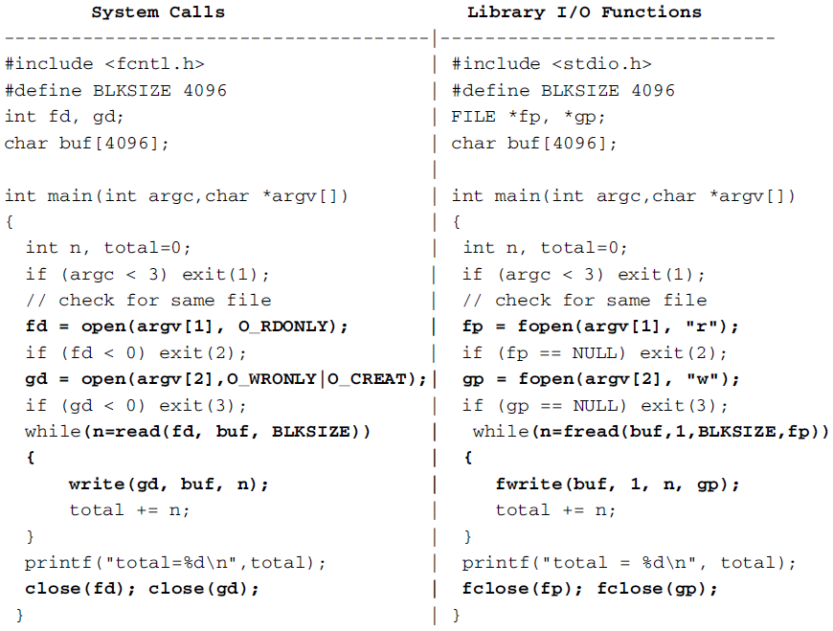
Example #2: ‘copy’ a file
Both programs in this example copy a src ﬁle to a dest ﬁle

Slide 11
Example #2 (cont.)
How does fopen() works in the library I/O function program?
fopen() returns a pointer to a file structure
Issues open() system call to open the ﬁle to get a ﬁle descriptor fd
If open() system call fails, fopen() returns a NULL pointer. Otherwise, it allocates a file structure in the program’s heap area
fopen() initializes file structure and returns fp, which points at the file structure.
Then it uses a while loop to copy the ﬁle contents. Each iteration of the while loop tries to read BLKSIZE (or, SIZE) bytes from the source ﬁle, and write n bytes to the target ﬁle, where n is the returned value from fread()

Slide 12

Example #2 (cont.)
Note that file structure is in process’ user mode image: calls to library I/O functions are ordinary function calls, not system calls
The general forms of fread() and fwrite() are
‘size’ is the record size in bytes
nitems is number of records to be read or written
n is actual number of records read or written.

Slide 13

Other library I/O functions -- fread() and fwrite()
These functions are intended for read/write structured data objects. For example, assume that the buffer area contains data objects of structured records
We may use the following to write nitem records to a ﬁle.
Or use the following to read nitem records from a ﬁle.

Slide 14
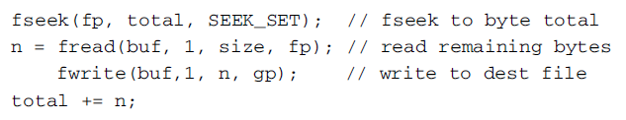
Other library I/O functions -- fread() and fwrite()
The above program tries to read/write BLKSIZE bytes at a time
It has size=1 and nitems=BLKSIZE
Any combination of size and nitems such that size*nitems=BLKSIZE would also work
However, using a size > 1 may cause problem on the last fread() because the ﬁle may have fewer than size bytes left. In that case, the returned n is zero even if it has read some data. To deal with the "tail" part of the source ﬁle, we may add the following lines of code after the while loop:

Slide 15
Other library I/O functions – fseek()
fseek() works exactly the same as lseek()
It positions the ﬁle's R|W pointer to the byte location total. From there, we read the ﬁle as 1-byte objects. This will read all the remaining bytes, if any, and write them to the target ﬁle.

Slide 16
Algorithms of Library I/O Functions

Slide 17

Algorithm of fread
Algorithm for fread() is as follows:
On the ﬁrst call to fread(), the file structure's buffer is empty
fread() uses fd to issue a system call to ﬁll the internal fbuf[ ]
read() system call initializes fbuf[ ]'s pointers, counters and status variables to indicate that there is a block of data in the internal buffer
read() system call then tries to satisfy fread() call from internal buffer by copying data to program's buffer area
If internal buffer does not have enough data, it issues additional read() system call to ﬁll the internal buffer and transfer data from the internal buffer to the program buffer

Slide 18
Algorithm of fread (cont.)
After copying data to program's buffer area, it updates the internal buffer's pointers, counters, … making it ready for next fread() request
fread() then returns the actual number of data objects read
On each subsequent call to fread(), it tries to satisfy the call from the file structure’s internal buffer
It issues a read() system call to reﬁll the internal buffer whenever the buffer becomes empty
Note:
fread() accepts calls from user program on one side and issues read() system calls to kernel on the other.
Except for read() system calls, all processing are performed inside user mode image

Slide 19
Algorithm of fwrite()
Similar to that of fread() except for the data transfer direction is different
Initially the file structure's internal buffer is empty
On each call to fwrite(), it writes data to the internal buffer, and adjusts the buffer's pointers, counters and status variable to keep track of the number of bytes in the buffer
If the buffer becomes full, it issues a write() system call to write the entire buffer to kernel

Slide 20
Algorithm of fclose
First ﬂushes the local buffer of the file stream if the ﬁle was opened for ‘write’
It then issues a close(fd) system call to close the ﬁle descriptor in the file structure
Finally, it frees the file structure and resets the file pointer to NULL

Slide 21
When to use what (I/O function or system call)?
Observations
fread() relies on read() to copy data from kernel to an internal buffer, from which it copies data to program's buffer area. It transfers data twice
read() copies data from kernel directly to the program's buffer area, which copies only once
General guideline
For read/write data in units of BLKSIZE, read() is inherently more efﬁcient than fread() because it only needs one copying operation instead of two

Slide 22
Library I/O Modes

Slide 23

Library I/O Modes
The ‘mode’ parameter in fopen() may be speciﬁed as "r", "w", "a“ for read, write, and append
Each mode string may include a + sign, meaning both ‘read’ and ‘write’
In cases of ‘write’ and ‘append’ it means create the ﬁle if it does not exist.

Slide 24
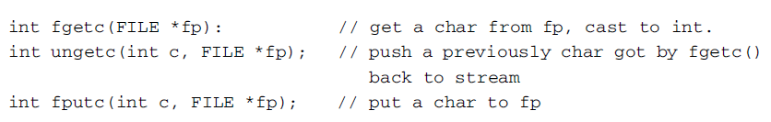
Char Mode I/O
fgetc() returns an integer, not a char. This is because it must return EOF on end of ﬁle. The EOF symbol is normally an integer -1, which distinguishes it from any char from the FILE stream.
For fp=stdin or stdout, c=getchar(); putchar(c); may be used instead.
For run time efﬁciency, getchar() and putchar() are often not shortened versions of getc() and putc(). Instead, they may be implemented as macros in order to avoid an extra function call.

Slide 25
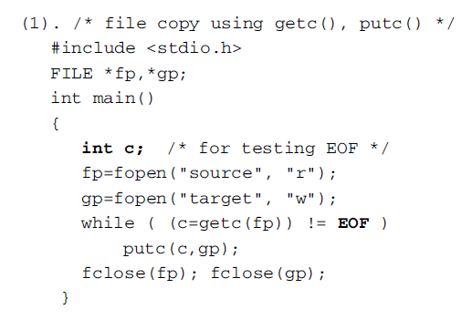
Char model I/O example
Exercise
Write a C program which converts letters in a text ﬁle from lowercase to uppercase.
Write a C program which counts the number of lines in a text ﬁle.
Write a C program which counts the number of words in a text ﬁle. Words are sequences of chars separated by white spaces.

Slide 26
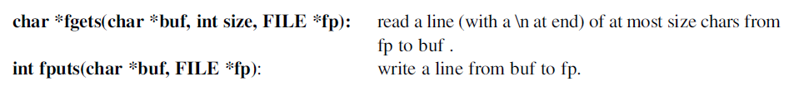
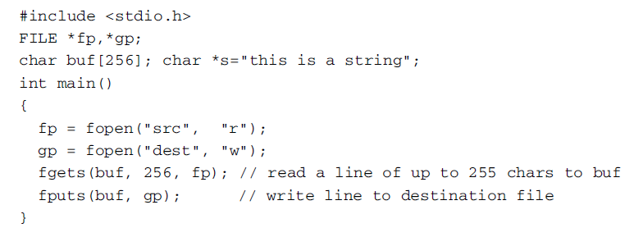
Line mode I/O
‘fgets’ and ‘fputs’ are line I/O functions
Example
When fp is stdin or stdout, the following functions may also be used but they are not shortened versions of fgets() and fputs().

Slide 27

Formatted I/O
These are perhaps the most commonly used I/O functions
Formatted Inputs: (FMT=format string )
Formatted Outputs:

Slide 28
In-memory Conversion Functions
sscanf() and sprintf() are not I/O functions but in-memory data conversion functions

Slide 29
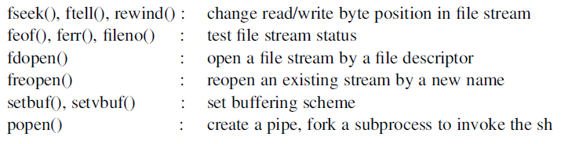
Other Library I/O Functions
Other library I/O functions are listed below

